Slide 1

School of Computer Science Engineering
Subject Name: Capstone Project-I Subject Code: R1UD704L
Hyperparameter Optimization Using
Various Optimizers
Submitted By:
Keshav Kumar 21SCSE1180171
Jayant Sikarwar 21SCSE1180159
Submitted to :
Dr. Sugan Patel
(Assistant Professor)

Slide 2
Hyperparameter Optimization: An Overview
Hyperparameter optimization is an essential aspect of machine learning. It focuses on fine-tuning the parameters that govern the learning process of a model. The goal is to achieve optimal performance on unseen data, making the model more robust and accurate.

Slide 3
Understanding Hyperparameters
1
Model Configuration
2
Learning Process
Hyperparameters control aspects of the model architecture and learning process. They dictate how a model learns and its ability to generalize to unseen data.
Examples of hyperparameters include learning rate, batch size, and regularization strength. These values directly influence the model's training and prediction performance.
3
Optimization Process
Hyperparameters are not learned by the model during training. They are set prior to training and play a crucial role in determining the model's final performance.

Slide 4
The Challenge of Manual Tuning
Time-Consuming
Limited Scope
Manually experimenting with hyperparameters is a tedious process. It can require extensive trial and error, consuming considerable time and resources.
Human intuition can be limited in identifying optimal hyperparameter combinations. Manually exploring a vast hyperparameter space might not be feasible or comprehensive.
Suboptimal Results
Manual tuning often leads to suboptimal results, as it's challenging to find the perfect balance of hyperparameters for complex models.

Slide 5
Different Optimizers
Gradient Descent
Stochastic Gradient Descent
A popular and widely used optimization technique that iteratively updates model parameters based on the gradient of the loss function.
An efficient variation of gradient descent that uses mini-batches of data for faster updates, making it suitable for large datasets.
Adam Optimizer
Genetic Algorithms
An adaptive learning rate optimizer that combines the benefits of RMSprop and AdaGrad, often providing faster convergence and better performance.
Inspired by biological evolution, these algorithms use a population of solutions and apply selection, crossover, and mutation to find the optimal hyperparameters.

Slide 6
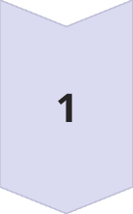
Introducing Optimization Algorithms
Grid Search
Bayesian Optimization
This method explores a predefined grid of hyperparameter values, systematically evaluating each combination.
This approach utilizes a probabilistic model to guide the search, leveraging past evaluations to prioritize promising areas of the hyperparameter space.
Random Search
Randomly samples hyperparameter values from a specified distribution, often more efficient than grid search for large hyperparameter spaces.

Slide 7
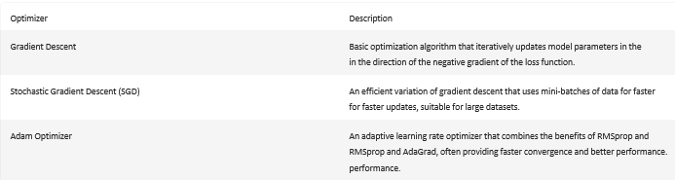
Gradient-Based Optimizers

Slide 8
Evolutionary Optimizers
Initialization
1
Starts with a random population of candidate solutions representing different hyperparameter combinations.
2
Fitness Evaluation
Each candidate solution is evaluated based on its performance on the given task, measured by a fitness function.
Selection
3
Candidates with higher fitness scores are more likely to be selected for reproduction, promoting the spread of successful traits.
4
Crossover and Mutation
Selected candidates undergo crossover (combining parts of different solutions) and mutation (randomly changing hyperparameters) to generate new offspring.
Termination
5
The process continues until a satisfactory solution is found or a termination criterion is met, such as reaching a maximum number of generations.

Slide 9
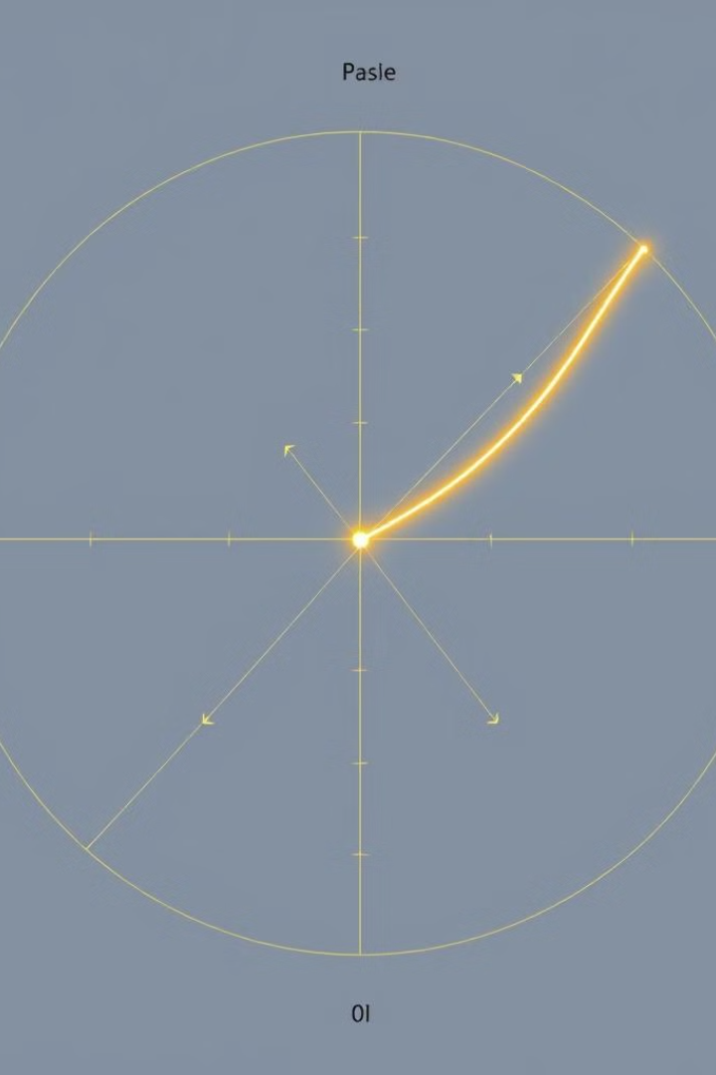



Optimization Techniques
Grid Search
A systematic exploration of a predefined grid of hyperparameter values
Bayesian Optimization
Utilizes a probabilistic model to guide the search, leveraging past evaluations to prioritize promising areas.
Random Search
Randomly samples hyperparameter values from a specified distribution.

Slide 10
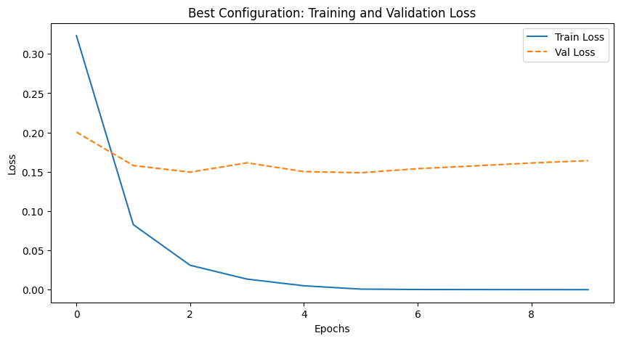
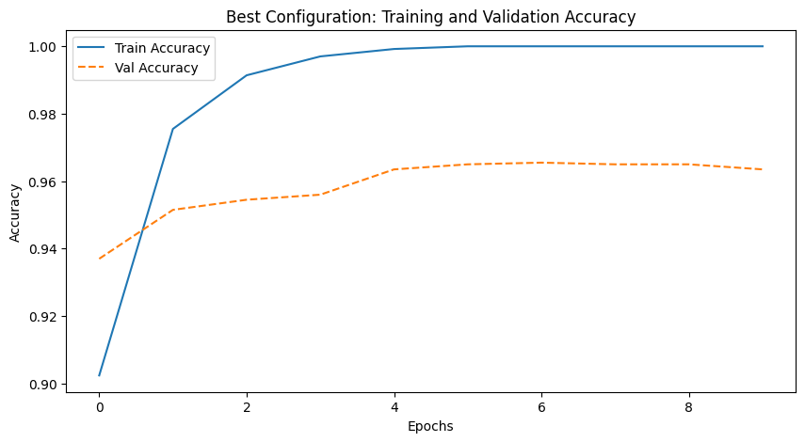
RESULTS

Slide 11
Practical Considerations and Takeaways
1
Dataset Size
2
Model Complexity
The size and complexity of the dataset influence the choice of optimization techniques and the time required for finding optimal hyperparameters.
More complex models often require more sophisticated optimization techniques to navigate the vast hyperparameter space and achieve good performance.
3
Computational Resources
Hyperparameter optimization can be computationally demanding, so it's crucial to consider available resources and optimize the search process accordingly.

Slide 12
THANK YOU

